Slide 1
系統軟體與平台
Project 2

Slide 2
大綱
Why is Multi-tasking
What is Threads?
How to Use Pthread
安裝Vtune
使用Vtune
報告說明

Slide 3
Why is Multi-tasking?
Abstract Concept

Slide 4
Why is Multi-tasking?
One man power is not enough
Unity is strength!
Moore’s Law goes to the end
CPU is multi-cores
GPU is multi-cores
FPGA is parallel

Slide 5


Parallelism is Creating Slaves
Counters in supermarket
Counters V.S. Cores
Shopping car V.S. Tasks
http://www.asiatu.com/
YU CHIH-WEI http://www.flickr.com/photos/shakingwave/5602830273/
Notes:
這邊要講排程

Slide 6


It’s NOT Dynamic Enough!
We need MORE labors!!
Change counter dynamically

Slide 7
Do We Really Benefit from Multi-tasking?
More than one core:
Execute many applications at once
Use all performance
Multiple task on one core:
Data dependency blocks
IO operation blocks

Slide 8
When Process meets Thread
Big V.S. Small – Make it light enough
Context switch – Moving whole car or box
Shared Memory – Shared shopping car
Different way to create – A Thread is lighter
V.S.

Slide 9
What is Threads?
On the other side…

Slide 10
What Does a Thread Look Like
A thread is task in a task
A thread is a smallest sequence of instructions that can be managed by operating systems.
CPU
Task
Task
Task
Notes:
開始帶入Thread的觀念

Slide 11
Threads
A thread is an independent stream of instructions
Independently executed by a processor core
The stream of instructions can be defined by a function or procedure
Threads can be managed by
Software, e.g. operating systems, thread library, virtual machine, etc.
Hardware, e.g. SMT/hyper threading, GPU

Slide 12
Processes and Threads
Are threads really independent?
Process
Process
Process
Thread
Thread
resource
resource
resource
copy
shared
shared
Process Creation
Thread Creation
No, unlike processes, threads in a process share certain resources
Why do you want two instruction streams to share resources?
Notes:
這邊最後問題可以帶領題目和互動

Slide 13
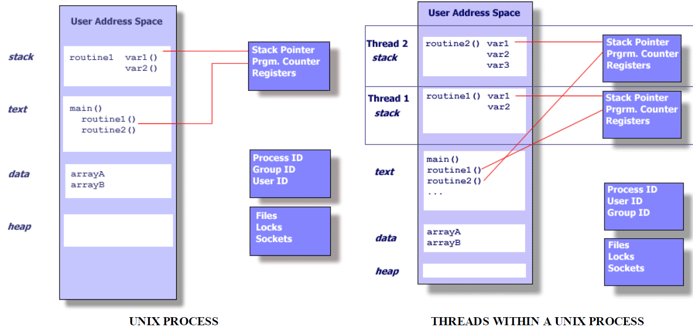
A Little Lesson about Linux Internals

Slide 14
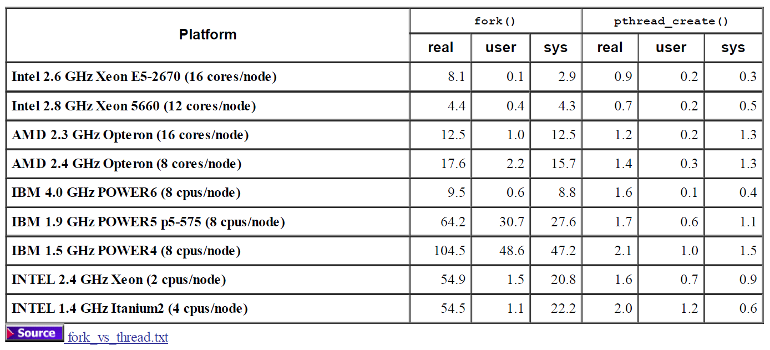
Creation Overhead

Slide 15
More about Threads
Pros:
Share the same code (no need to make copies)
Share the same global data (no copies)
Easy to exchange data
Cons:
Race conditions
Must run with shared memory
Notes:
To maximize performance, control the scheduling of threads is critical
Number of threads
Assignment of threads to CPU/GPU cores
Priority of threads

Slide 16
Quick Test
How does the OS create a new process?
How does Pthread create a new thread?
What if you have many threads and only one CPU?
What if you have M threads and N CPUs?
Are all threads treated equally by the OS/Pthreads?
What if two threads want to access the same global variables at the same time?

Slide 17
Quick Test
How does the OS create a new process?
Create the needed sections and load the program/data
How does Pthread create a new thread?
Just need to create new private sections (e.g. PC, reg, stack)
What if you have many threads and only one CPU?
Context switch periodically: Save the state of one thread; suspend; load the state of another thread; run.
What if you have M threads and N CPUs?
Complicated – no perfect solutions, but the OS tries to do its best by migrating threads and balancing the number of threads; Sometimes users want to bind the threads to CPU
Are all threads treated equally by the OS/Pthreads?
The priority of a thread can be adjusted by the application
What if two threads want to access the same global variables at the same time?
Race condition!

Slide 18
How to Use Pthread
Step by step

Slide 19
How to Use Pthread
Basics
Creation and join of threads
Master-Worker Model
Degree of parallelism
Communications
Threads synchronization

Slide 20
How to Use Pthread
GNU/Linux implements the pthreads.
All thread functions and data types are declared in the header file <pthread.h>.
The pthread functions (not included in the standard C library) are in libpthread
Add –lpthread to the command line when you link your program.
(source) Advanced Linux Programming by CodeSourcery LLC, http://www.advancedlinuxprogramming.com/

Slide 21
Naming Convention
Thread management functions
“pthread_XXX”
pthread_create() , pthread_exit()
Thread attribute functions
“pthread_attr_XXX”
pthread_attr_init(), pthread_attr_destroy()
Thread synchronization functions
“pthread_mutex_XXX” or “pthread_cond_XXX”
pthread_mutex_init(),pthread_mutex_lock()
pthread_cond_signal() , pthread_cond_wait()
(source) Advanced Linux Programming by CodeSourcery LLC, http://www.advancedlinuxprogramming.com/

Slide 22
Naming Convention
pthread_create (tid, attr, func, args)
Creates a new thread to execute a routine (i.e. thread function)
The parent thread continues to run
Parent thread may pass data to its child thread during creation
Thread ID
Each thread in a process is identified by a thread ID.
When referring to thread IDs in C or C++ programs, use the type pthread_t
(source) http://www.cs.mtu.edu/~shene/NSF-3/e-Book/FUNDAMENTALS/thread-management.html

Slide 23
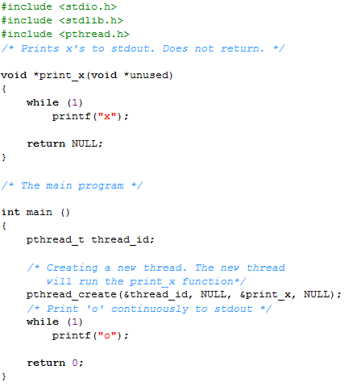
Example:Create a Thread
Include pthread.h
Child thread keeps printing “x”
Define a thread ID
Create a thread to run print_x(), do not need to pass parameters here
Parent thread continues and keep printing “o”

Slide 24
Exit of a Thread
Under normal circumstances, a thread exits in one of two ways.
Normally returning from the thread function. The return value from the thread function is taken to be the return value of the thread.
A thread can exit explicitly by calling pthread_exit(). This function may be called from within the thread function or from some other function called directly or indirectly by the thread function.
The argument to pthread_exit is the thread’s return value.
Thread can be terminated from another thread
pthread_cancel (thread_t tid)
(source) Advanced Linux Programming by CodeSourcery LLC, http://www.advancedlinuxprogramming.com/
Notes:
和return不一樣的地方，如果我們有用pthread_cleanup_push()指定任何一個function的話，return並不會執行任何cleanup function，如果使用pthread_exit()，他會在離開前呼叫我們指定的cleanup function來釋放我們所用過的記憶體，避免memory leak。

Slide 25
Example:Passing Data
Use the thread argument to pass a pointer to some structure or array of data.
One commonly used technique is to define a structure for each thread function, which contains the “parameters” that the thread function expects.
Using the thread argument, it’s easy to reuse the same thread function for many threads. All these threads execute the same code, but on different data.
(source) Advanced Linux Programming by CodeSourcery LLC, http://www.advancedlinuxprogramming.com/

Slide 26
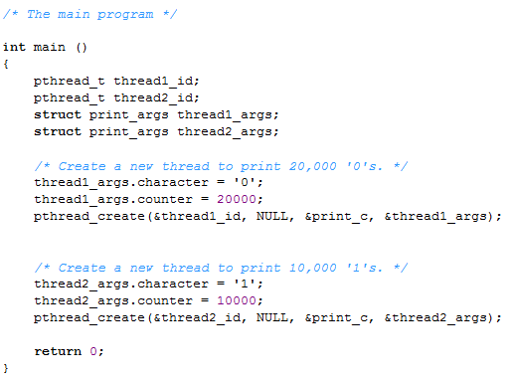
Example: Creation of 2 Threads (1/2)
Define two thread IDs
Arguments to pass to thread functions
Setting up arguments for thread 1
Create a thread to run print_c(), with arguments
Create a thread to run print_c(), with arguments
Parent thread exit immediately!
Notes:
26

Slide 27
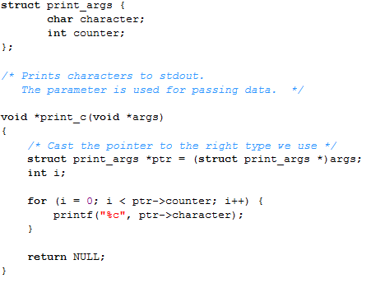
Example: Creation of 2 Threads (2/2)
Local variables within thread function are private, i.e. only this thread see them
This illustrates Single-Program Multiple Data (SPMD)
20000 “0” and 10000 “1” mixed in a random order
Two threads execute independently in MIMD fashion, not SIMD
Data dependencies exist!
Both threads call printf() to print characters to the same device stdout
The contention occurs at OS level and it serializes execution
(source) Advanced Linux Programming by CodeSourcery LLC, http://www.advancedlinuxprogramming.com/
Notes:
27

Slide 28
Bug in the Example
The example has a serious bug in it.
The main thread creates the parameters (thread1_args, thread2_args) as local variables.
The main thread finished before (or while) the other two threads are executing.
Segmentation Fault (Wrong Pointer)！
How can we solve this problem?
Use global variables
Wait till all thread are done
(source) Advanced Linux Programming by CodeSourcery LLC, http://www.advancedlinuxprogramming.com/

Slide 29
Join of Threads
In order to solve problem…
pthread_join(pthread_t thread, void **retval)
thread – The thread ID to wait for
retval – A pointer to receive return value
(source) Advanced Linux Programming by CodeSourcery LLC, http://www.advancedlinuxprogramming.com/

Slide 30
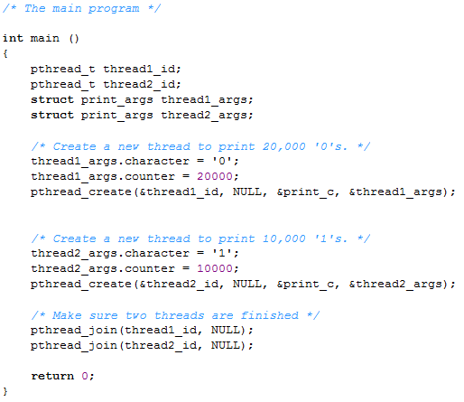
Bug fixed
Wait till finished to prevent local data deallocation
Notes:
30

Slide 31
Symbols in <pthread.h>
PTHREAD_CANCEL_*
PTHREAD_COND_INITIALIZER
PTHREAD_CREATE_DETACHED
PTHREAD_CREATE_JOINABLE
PTHREAD_EXPLICIT_SCHED
PTHREAD_INHERIT_SCHED
PTHREAD_MUTEX_*
PTHREAD_ONCE_INIT
PTHREAD_PRIO_*
PTHREAD_PROCESS_SHARED
PTHREAD_PROCESS_PRIVATE
PTHREAD_RWLOCK_INITIALIZER
PTHREAD_SCOPE_*
The Single UNIX ® Specification, Version 2 Copyright © 1997 The Open Group

Slide 32
A Little Lesson about Linux Internals
Please download this book on-line http://www.advancedlinuxprogramming.com/alp-folder/advanced-linux-programming.pdf
Part I
Writing good Linux software
Processes
Threads
Inter-processes communication

Slide 33

Master-Worker Model
Master thread (main)
Set up environment
Create worker threads
…..
Join the worker threads
Continue execution after all worker threads are joined
Worker
threads
Worker threads
Worker threads
Perform thread function
Termination of itself
Master
Thread
pthread_creatre()
pthread_join()
2
3
4
1
Worker
Thread
2
pthread_exit()
Worker
Thread
1
Do Work
Notes:
#include <pthread.h>
pthread_t thread;
void **status;
int pthread_join (pthread_t thread, void **value_ptr);
Parameters
thread: Specifies the target thread.
status: Points to where the termination status of the target thread will be stored. If the value is NULL, the termination status is not returned.
Return Values
If successful, the pthread_join function returns zero. Otherwise, an error number is returned to indicate the error.
33

Slide 34
Degree of Parallelism
How well a program is parallelized
More threads = Better performance?
Ex: Gray-scale Transfer program
V.S.
Notes:
這邊要探討執行序太多會怎樣太少會怎樣，舉範例程式圖像灰階化

Slide 35
Degree of Parallelism(1/4)
How many cores does this computer might have?
Notes:
8 cores
4 cores 2 threads
都可
這邊還要介紹資料分割問題 Coarse-Grained還有Fine-Grained
要問大家三個Performance 的差別的原因

Slide 36
Degree of Parallelism(2/4)
How many cores does this computer might have?
Notes:
8 cores
4 cores 2 threads
都可

Slide 37
Degree of Parallelism(3/4)
How many cores does this computer might have?
Notes:
8 cores
4 cores 2 threads
都可

Slide 38
Degree of Parallelism(4/4)
How many cores does this computer might have?
Notes:
8 cores
4 cores 2 threads
都可

Slide 39

What’s the differences?
2
1
0.25
0.0625
Notes:
6528X4896 2
3264X2448 1
816X612 0.25
204X153 0.0625

Slide 40
Vtune
Installation

Slide 41
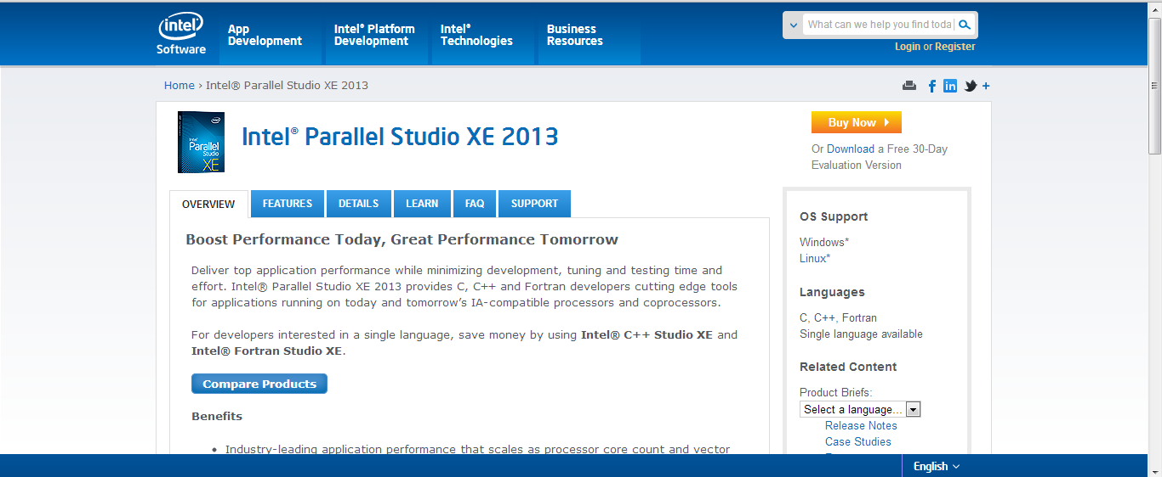
Download Full Version

Slide 42
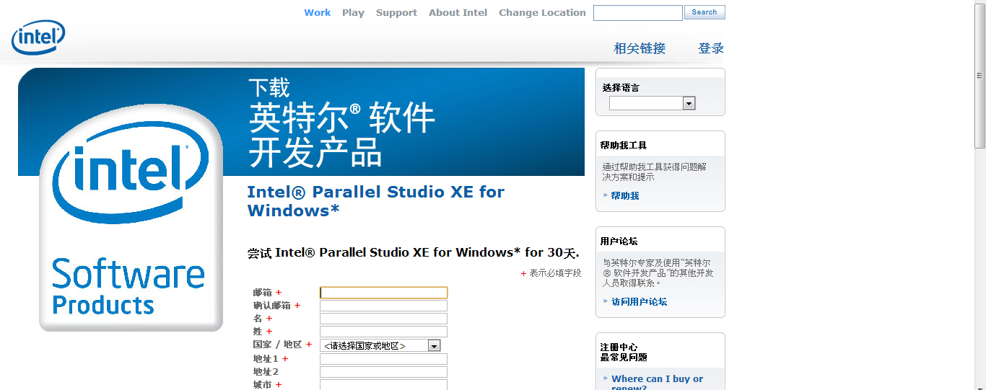
Only e-mail is important

Slide 43
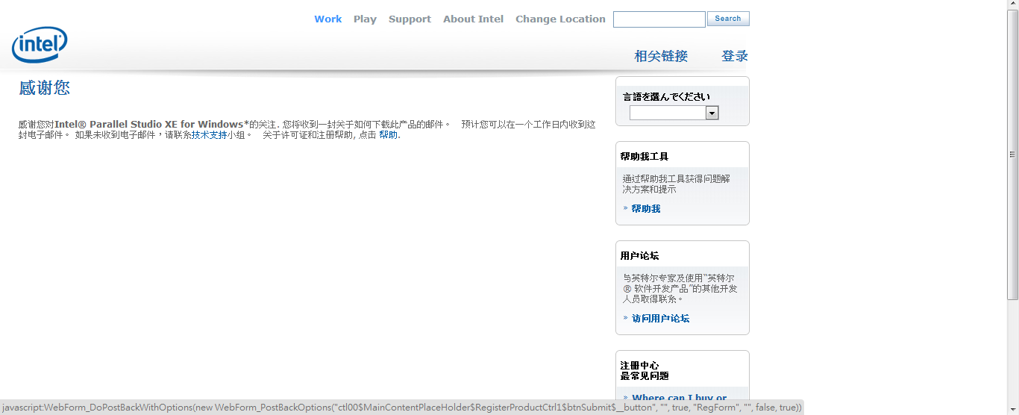

Slide 44
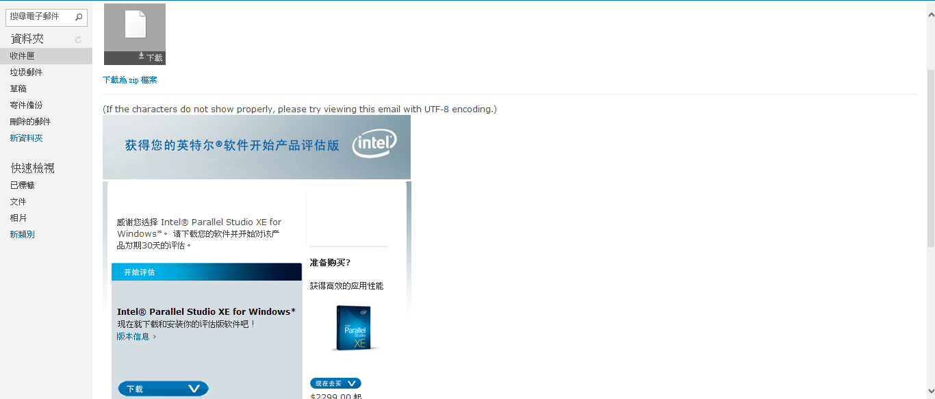
Download link

Slide 45

Get your code

Slide 46
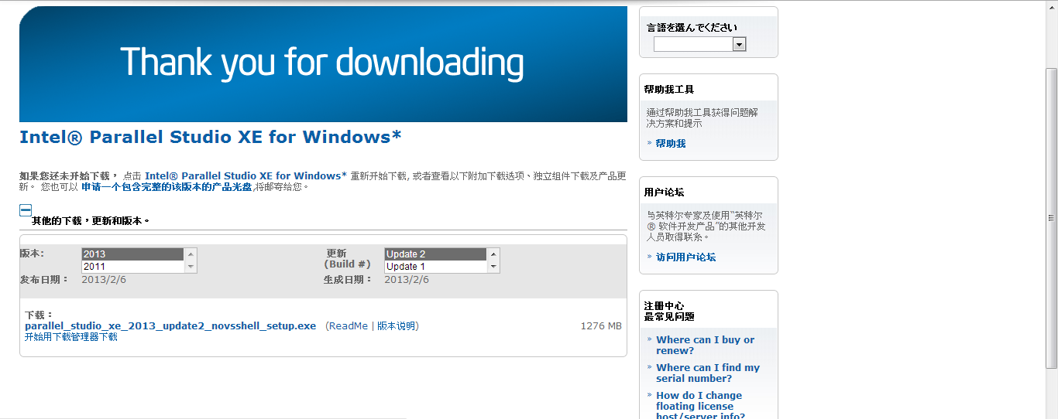
2013 Update 2

Slide 47
Vtune
Tutorial

Slide 48
Intel® VTune™ Advisor XE
Tell how much parallelism could be.
Testing program by steps.

Slide 49
Intel® VTune™ Inspector XE
Locate bugs in your multi-threaded programs.
Finding data race conditions.
Leakage and Memory

Slide 50
Intel® VTune™ Amplifier XE
Provides information on code performance.
Identify where and how application can benefit from available hardware resources.
Target:
The most time-consuming functions
Efficient utilization
The performance impact on different synchronization

Slide 51
使用介紹
Intel® VTune™ Amplifier XE

Slide 52
Intel® VTune™ Amplifier XE
Locks and Waits
Hotsopts
Concurrency

Slide 53
Hotspot Analyze
Identify hotspot.
Unlike Lightweight Hotspots, Hotspots collects stack and call tree information.
Sample all processes.

Slide 54
Concurrency Analyze
Identify CPU usage.
Identify where to parallelize.

Slide 55
Locks and Waits Analyze
Identify where thread was waiting.
Synchronization points.
IO operation counts

Slide 56
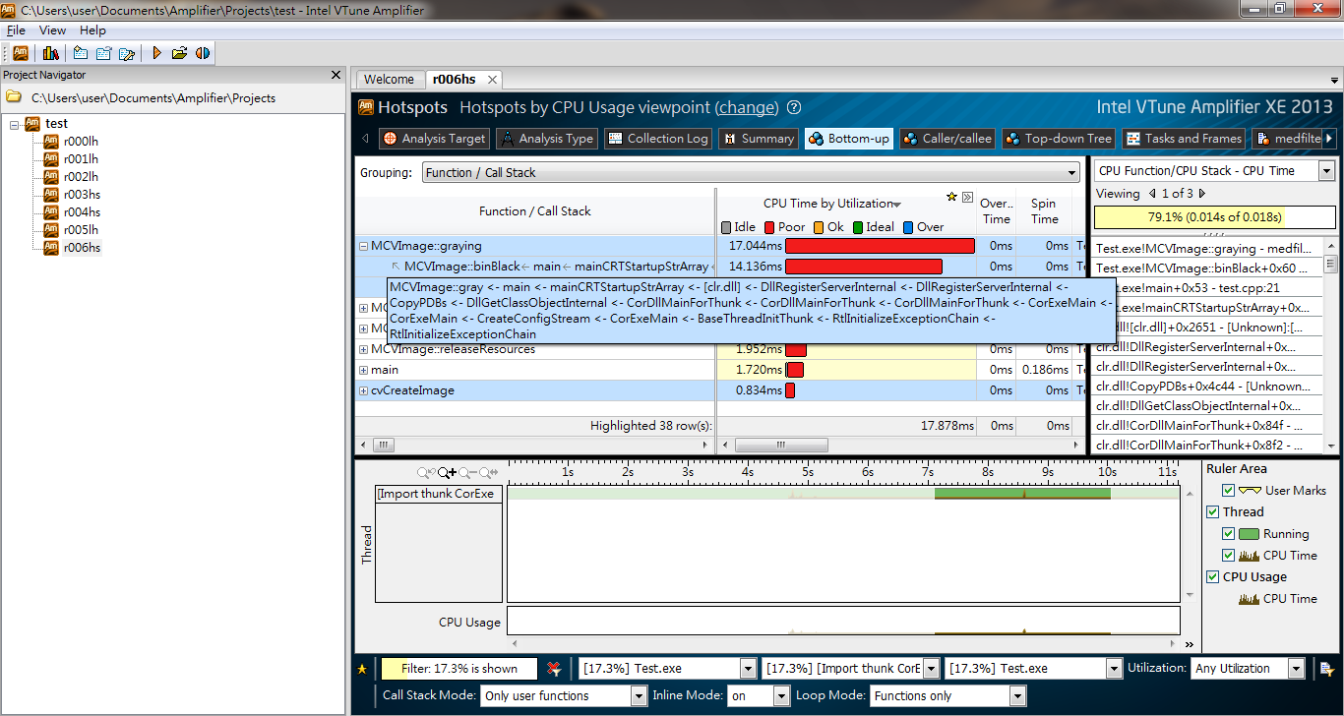

Slide 57
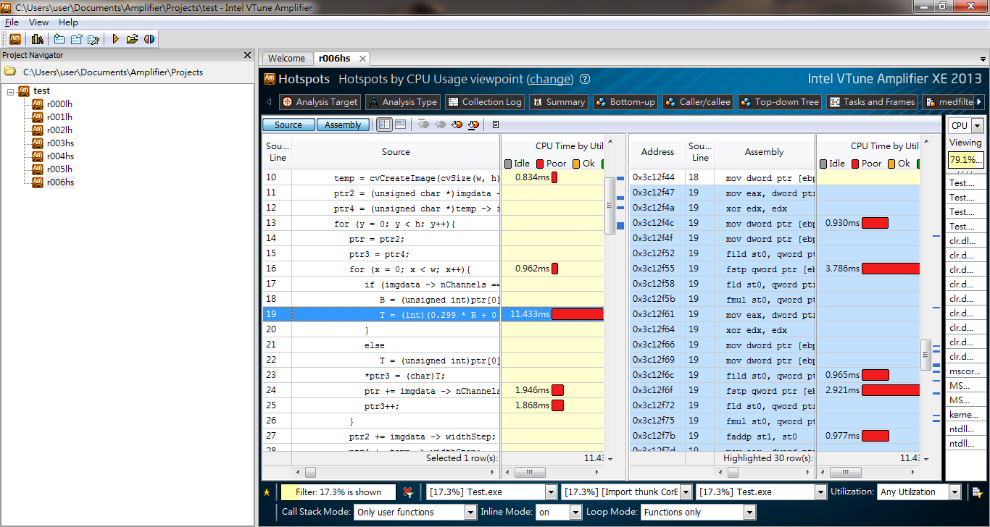

Slide 58
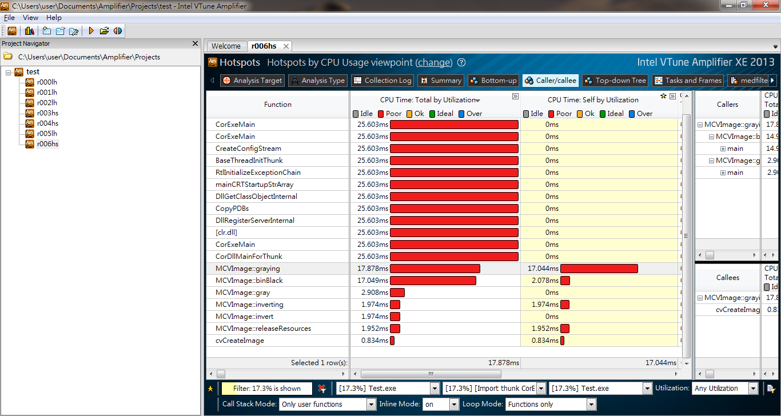

Slide 59
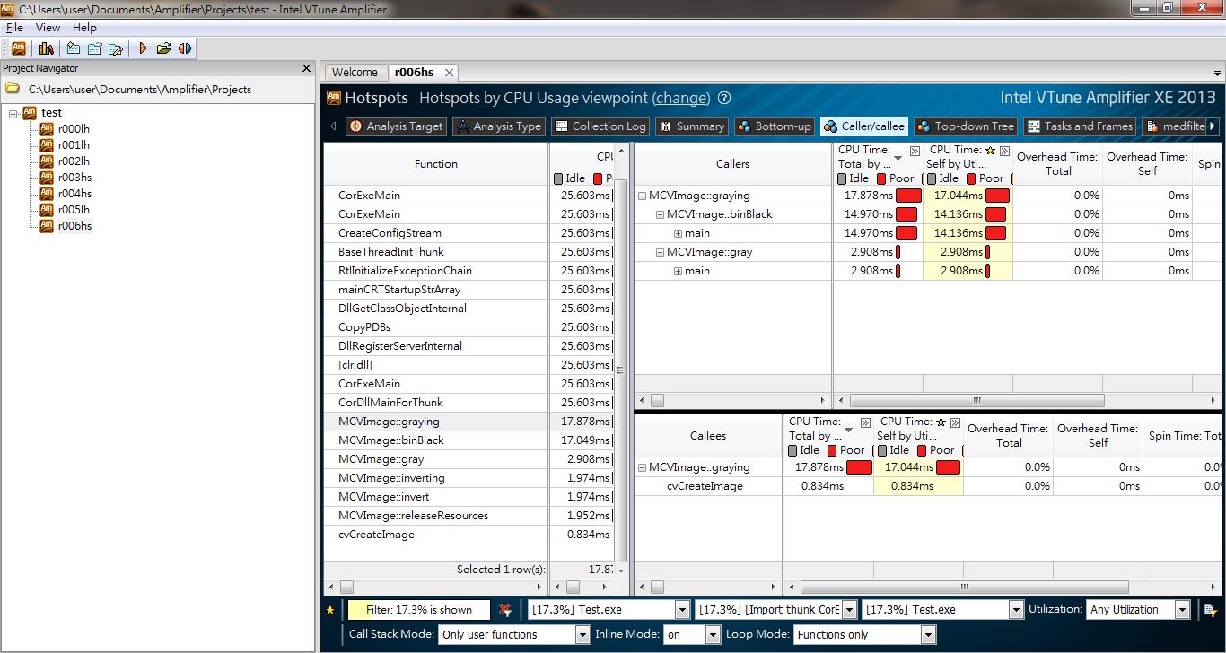

Slide 60
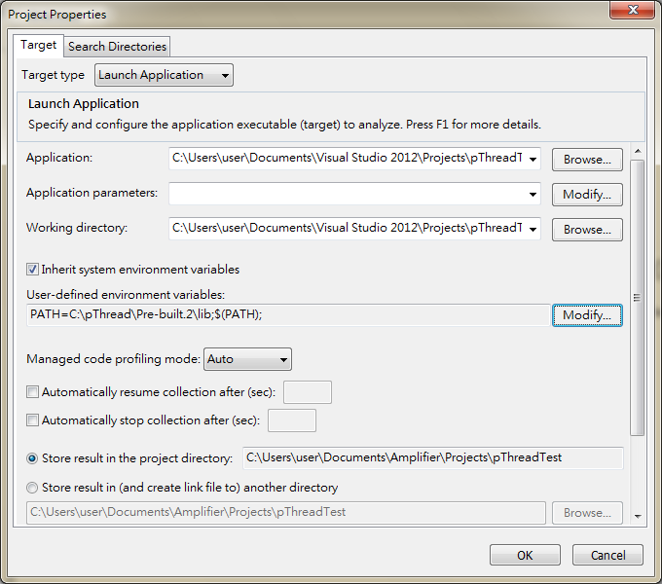
Notes:
設定執行檔位置

Slide 61
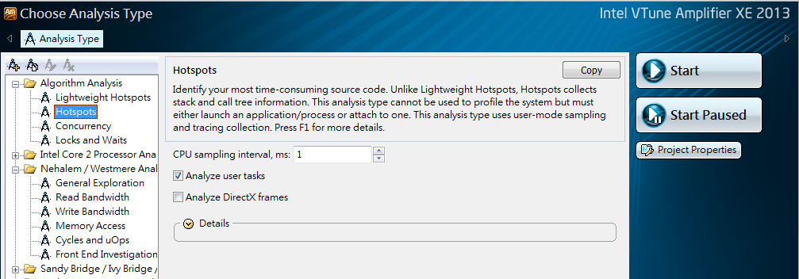

Slide 62
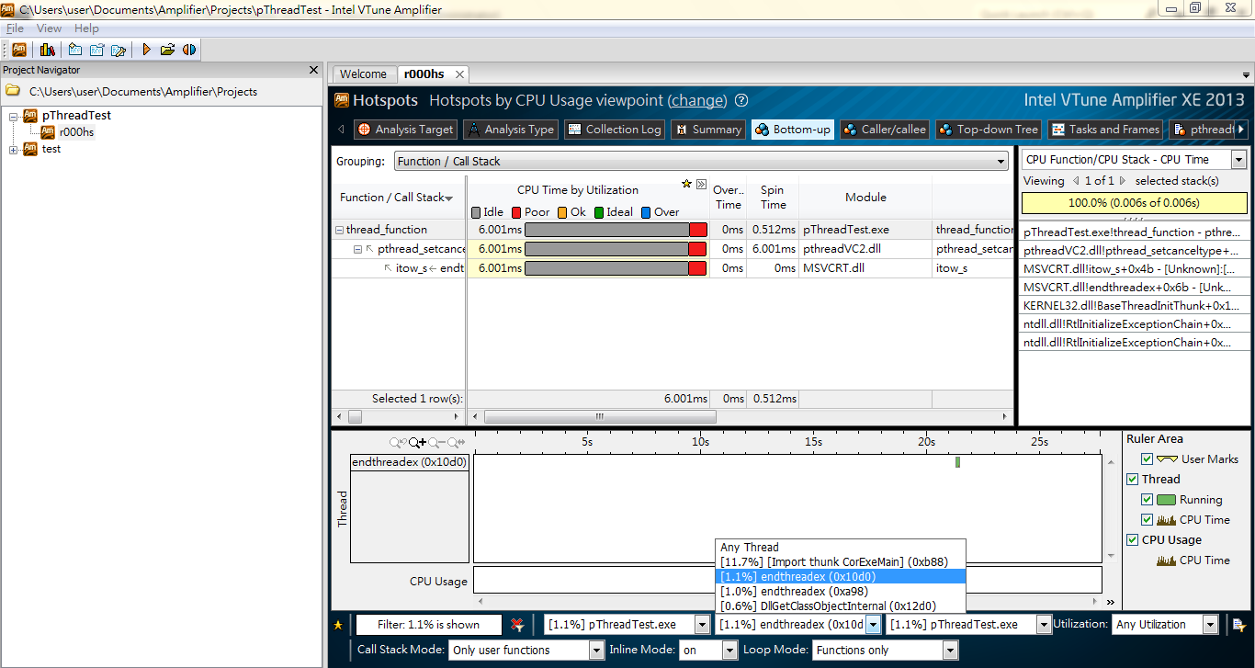

Slide 63
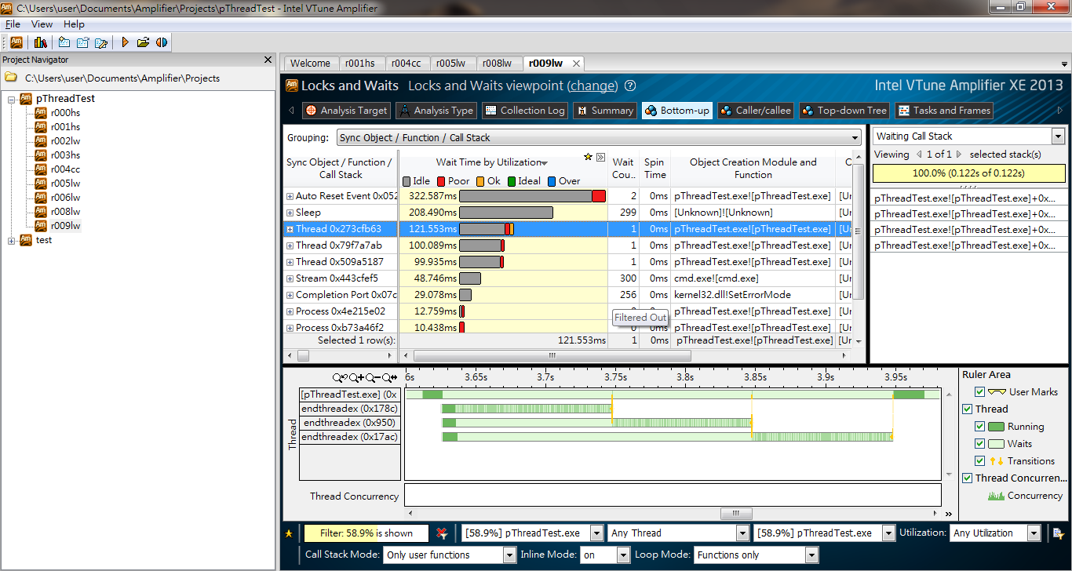
Coarse Grained

Slide 64
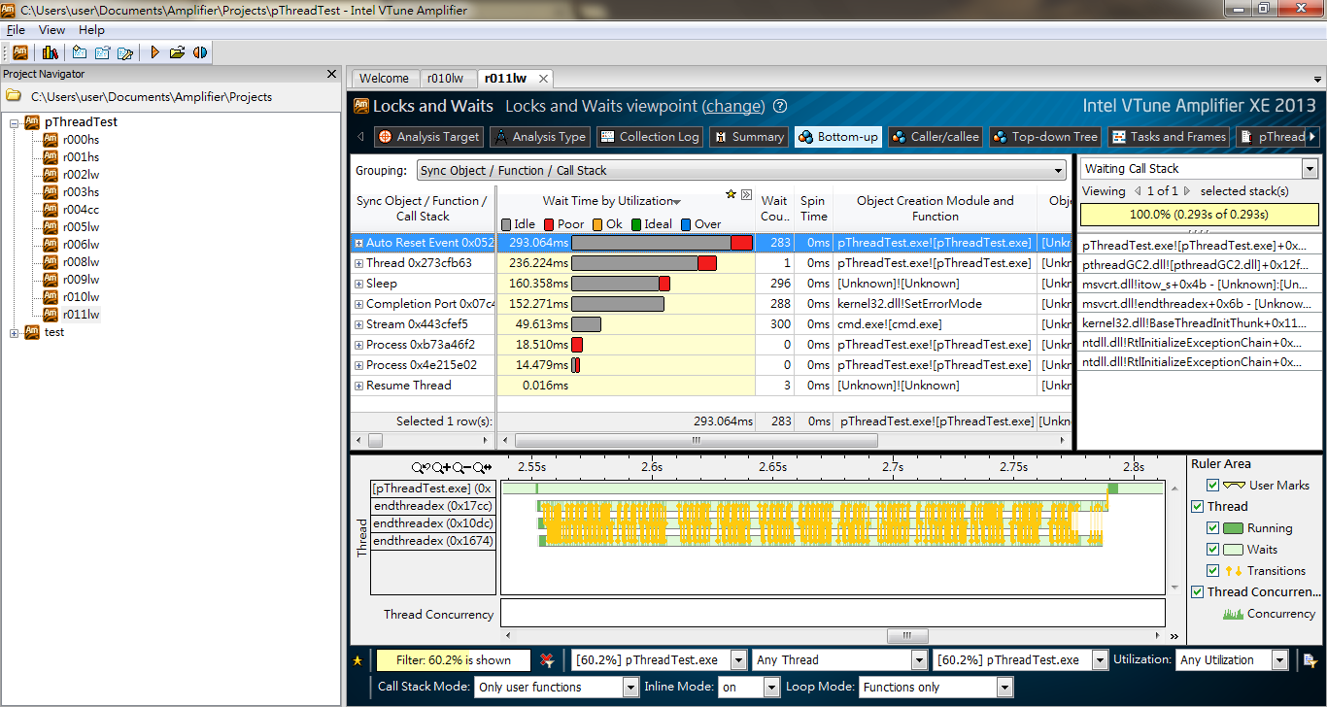
Fine Grained

Slide 65
作業內容
附檔中有nqueens_bestSerial、nqueens_naive、nqueens_parallel
請改善nqueens_parallel這隻程式，讓他效能變更好，並比較以下
用Coarse Grained的方式平行化和Fine Grained的方式比起來，哪一種比較適合DFS的問題。
什麼情況和什麼時候分多少個thread會比較快請比較nqueens_bestSerial和你的程式的結果

Slide 66
報告內容
統一格式
只要求結果和分析
不可超過兩頁

